Slide 1

Insights on the Popularity and Profitability of Movies from 1920 to 2020¶ Author: Rose Kyalo

Slide 2

Introduction.
Our goal is to help company X identify the types of movies currently thriving and suitable for production in their studio.
In this analysis, we will explore "The Numbers Movie Budget" dataset from The Numbers website.

Slide 3
Key Questions
We will focus on three key questions:
What types of movies are performing exceptionally well in terms of popularity and profitability?
How has the profitability of movie production evolved from 1920 to 2020?
Does the production budget significantly influence overall movie profit?
By addressing these questions, we aim to provide valuable insights that will assist company X in making informed decisions and formulating effective movie production strategies

Slide 4
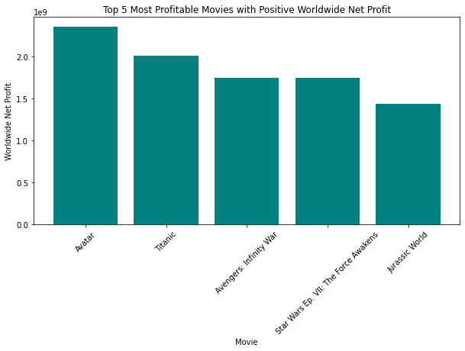
Top Movies excelling in popularity and profitability.
Avatar , Titanic , Avengers: Infinity War , Star Wars Ep. VII: The Force Awakens , Jurassic World are top five movies that made a positive profit worldwide.
Our strategy on production of movies should focus on movies that have a global appeal.

Slide 5
Profitability Evolution
The movie industry has been producing movies since 1920 up to the latest movie released on December 31st 2020.
It has shown remarkable consistency in its profitability over the years, indicating a strong and enduring success in the movie industry.

Slide 6


Slide 7
Production Budget Impact
Our analysis has shown that higher investments in movie production have a direct impact on the financial success of the movies, leading to higher returns both in the domestic market and on a global scale.
As shown in the scatter plots below, as production budget increases both domestic and worldwide profit increase.
We look at the correlation coefficient of production budget and worldwide profit is 0.7727. This shows a strong positive relationship between the two hence supporting our statement above.

Slide 8
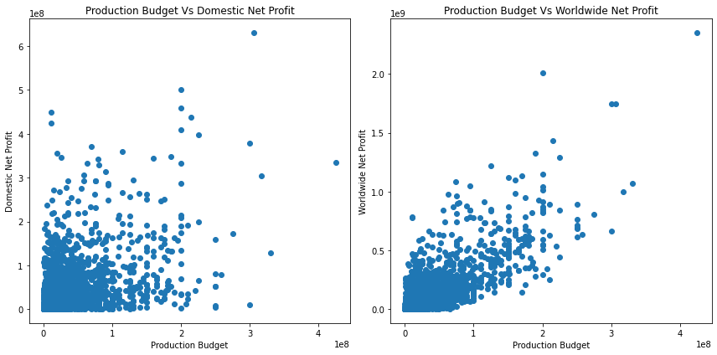

Slide 9
Key Findings
Prioritize movies with global appeal for higher profitability.
Learn from successful movies like Avatar, Titanic, Avengers: Infinity War, Star Wars Ep. VII: The Force Awakens, and Jurassic World.
Emulate movies that achieved profitability both domestically and worldwide, such as Titanic, Jurassic World, and Star Wars Ep . VII: The Force Awakens.

Slide 10
Recommendations
Focus on creating internationally appealing films.
Conduct market analysis to identify audience preferences.
Consider collaborations with experienced production houses.
Potential for Success:
Movie industry has consistent growth since 1920.
Embrace innovation and adapt to changing preferences.
Thrive in the dynamic and competitive movie industry.

Slide 11
Conclusion
Global appeal, learning from successful movies, and strategic budget allocation are key to success.
Company X is poised for success in the dynamic movie industry.
Commitment to quality storytelling and audience engagement is vital.
Thank you for your attention, and let's embark on this exciting journey together.

Slide 12
Thank You

